Slide 1

HR ATTRITION DASHBOARD
BY SAURAV YADAV

Slide 2
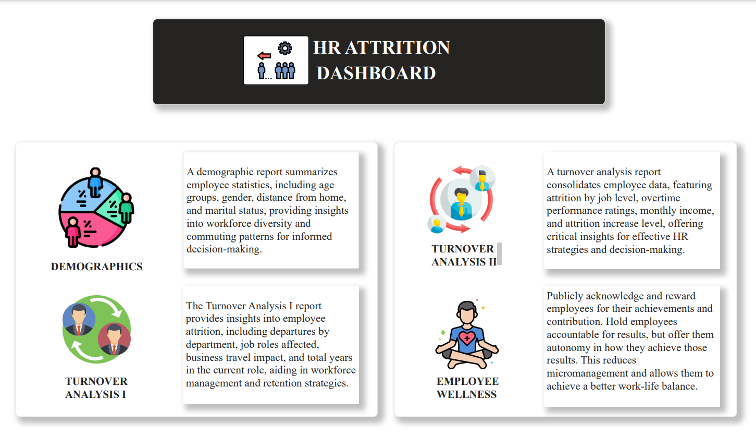

Slide 3
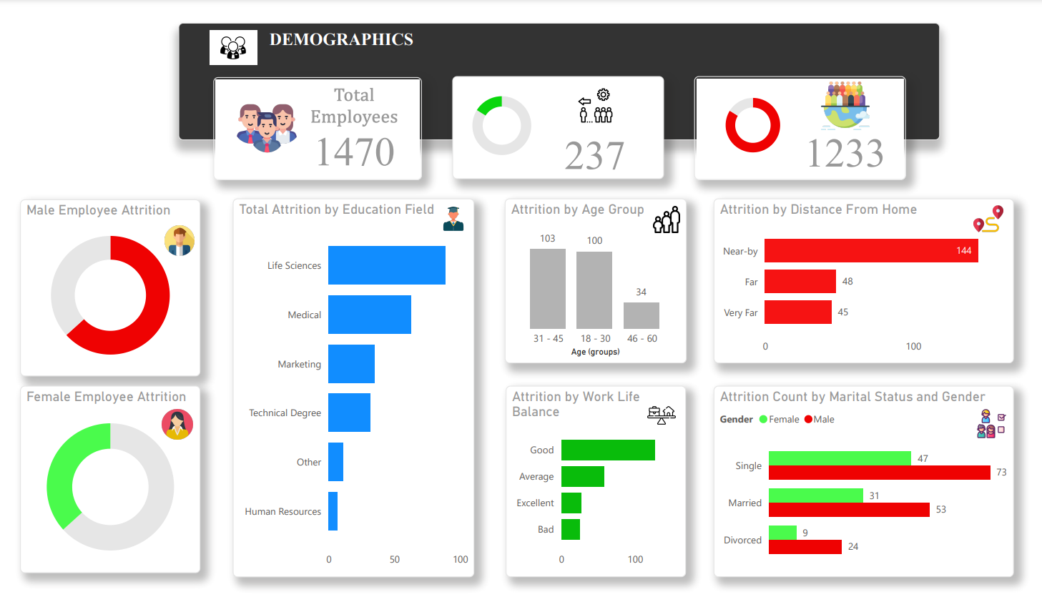

Slide 4
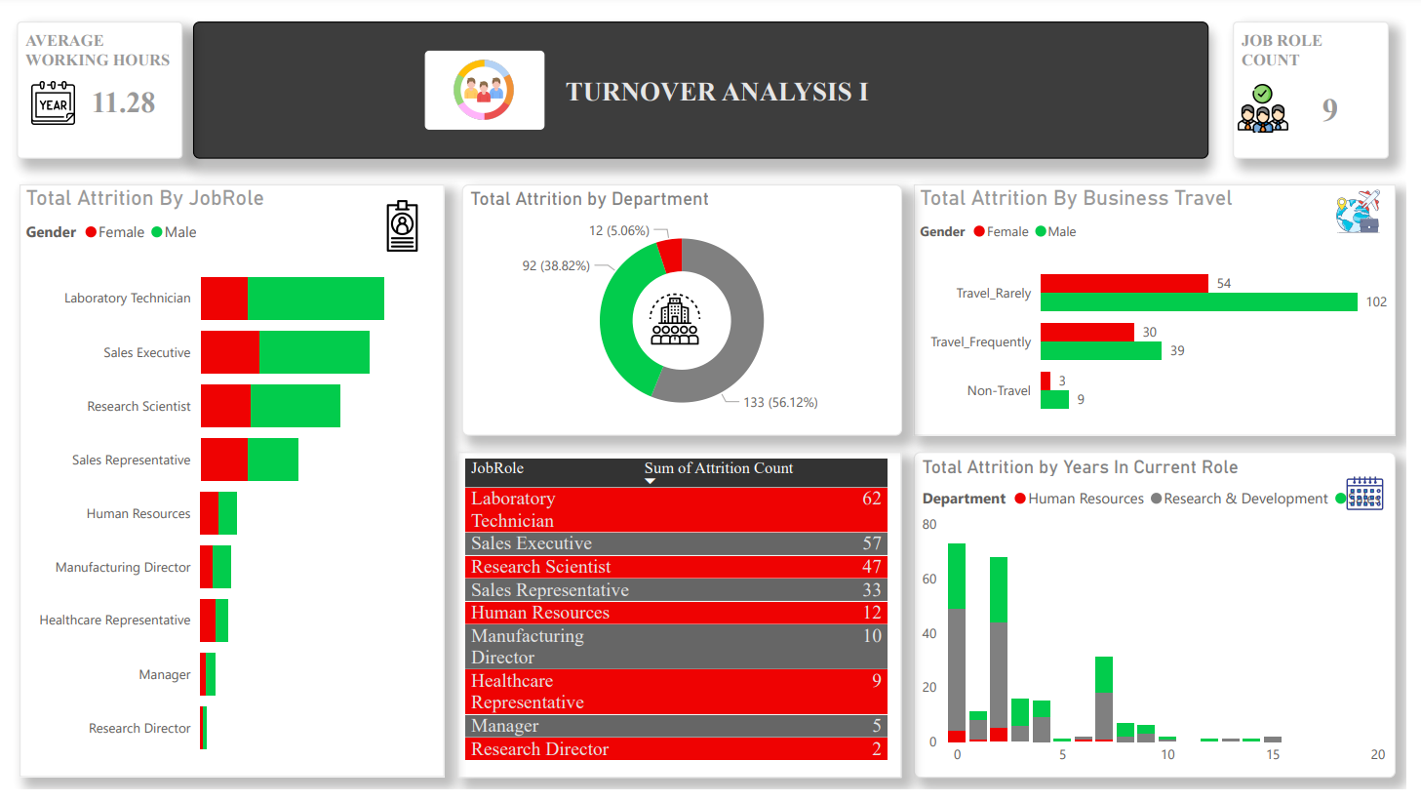

Slide 5
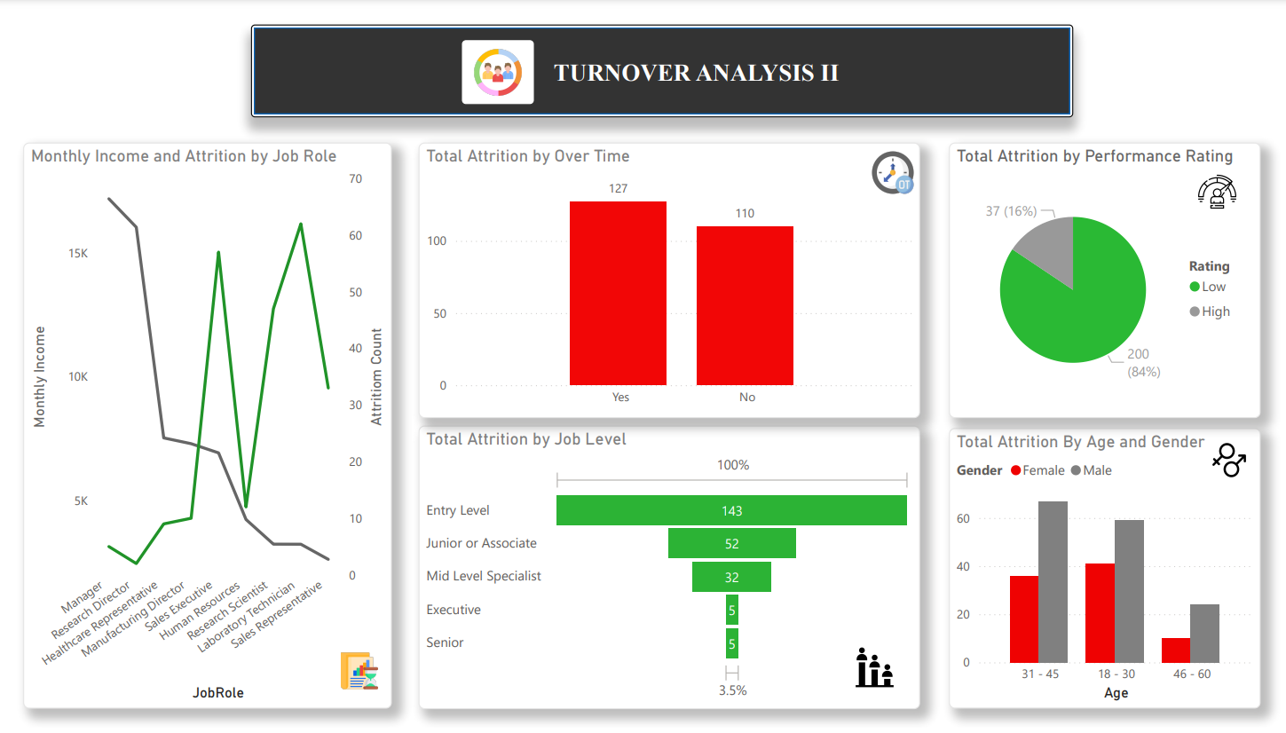

Slide 6
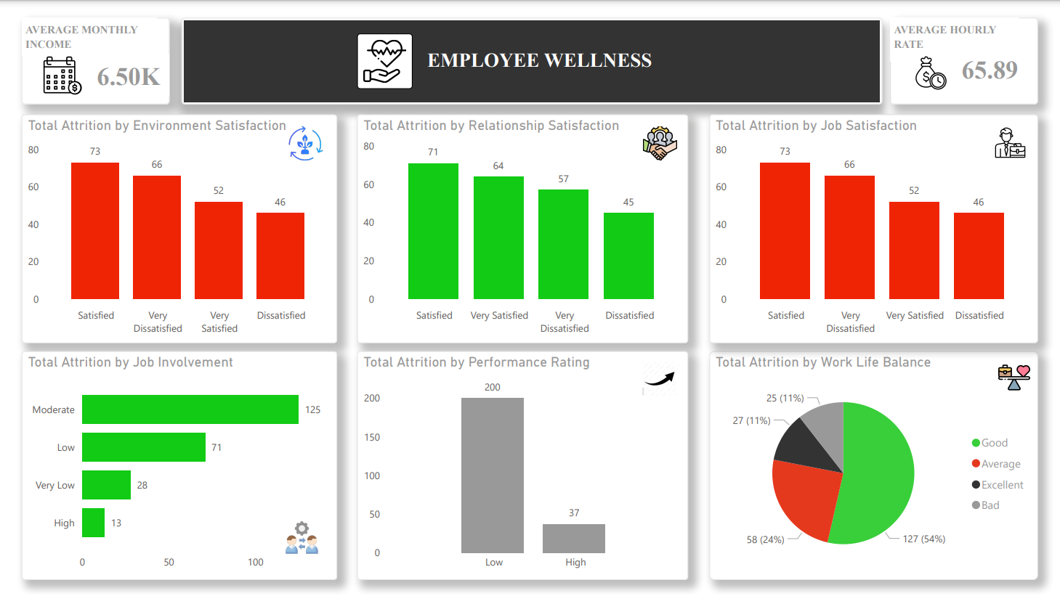

Slide 7
THANK YOU

